Slide 1
“Free from the shackles of Test Driven Development”
How to successfully introduce BDD using SpecFlow into your development project
Richard Allen
t: @rich_allen
e: rich@leavewizard.com
Notes:
Thank you for coming tonight.
This is a story of my own experiences, what works for this team may well not work for your team but hopefully you can take something away from tonight.

Slide 2

About me
Notes:
Richard Allen
Software developer for over 15 years based in Bournemouth
Co-Founder of Developer South Coast
Co-Founder of LeaveWizard.com
Currently contracting with Fitness First in Poole
How many people currently do TDD?
How many do BDD?

Slide 3

The Challenge
Notes:
Asked to go to Fitness First as they embarked on a new rebrand and implementation of a digital platform to support their efforts over the coming years.
Project included rebranding 9 international websites based upon around an EpiServer CMS
Implementation of a Windows Azure based digital platform with an Api to support a web based portal together with an iOS and Android mobile applications.
The project was to be implemented with two external digital agencies providing user interface design and implementation support.
It was a greenfield project which laid the perfect foundations to put together a solid automation framework that would allow the team to develop at a continuous sustainable pace.

Slide 4

The Team
Notes:
2 - Scrum teams
1 x digital platform development
1 x website development
Each team consisted of:
3 x Developers
2 x Testers
1 x Business Analyst/Product Owner

Slide 5
Problem: Feature development
Pre-Plan
Develop
Pre-Plan
Develop
Move to next feature
Developers
Pre-Plan
System Test
Regression Test
Wait for Developers
Testers

Slide 6
Problem: Release Cycle
We HAVE NOT affected anything else
We SHOULD NOT have affected anything else
We MAY HAVE affected something else
We have run out of time to regression test
SHIP IT anyway!
Sprint 1
Sprint 2
Sprint 3
Regression Sprint

Slide 7
Future: Feature development
Regression Test
Regression Test
Regression Test
Regression Test
Regression Test
Automation
Pre-Plan
Develop
Verification
Pre-Plan
Developers
Move to next feature
Pre-Plan
Test Automation
Verification
Pre-Plan
Testers

Slide 8
Future: Continuous Delivery
SHIP IT!
SHIP IT!
SHIP IT!
SHIP IT!
Sprint 1
Sprint 2
Sprint 3
Sprint 4

Slide 9
Team dynamic
Great at testing
Testers
Cross functional team
Developers
Great at developing
Notes:
The team’s experience was probably fairly typical for most teams.
The testers were generally good at manual exploratory testing and general testing practices i.e. identifying missing requirements, breaking stuff etc
The developers were good developers
The important thing was that everyone on the team was open minded and willing to try new things – and this is very important

Slide 10
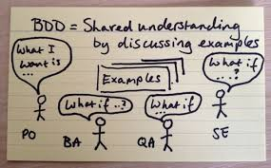
Introducing BDD
Shared understanding by discussing examples
Notes:
So what are the first steps...

Slide 11
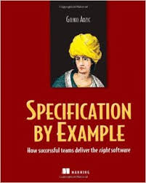
Read this!
Notes:
To help you better understand how it can vary between teams

Slide 12
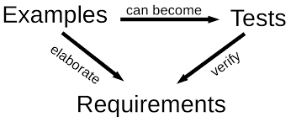
Why Examples?
Notes:
How do we capture examples...

Slide 13

What’s in a story?
Notes:
BDD uses a language syntax called Gherkin, you may be familiar with it already

Slide 14
Gherkin: User Story
Title [One line describing the story] In order to [benefit] As a [role] I want [feature]

Slide 15
Gherkin: Scenarios
Scenario: Title Given [context] And [some more context] When [event] Then [outcome] And [some other outcome]

Slide 16
A little tense?
Given [Context]
Happens in the past
“Given Fred bought a microwave”
“Given Pat’s holiday has been approved”
“Given the last bar of chocolate was sold”

Slide 17
A little tense?
When [event]
Happen in the present
“When I go to the checkout”
“When Bob adds the gig to his calendar”
“When a customer buys the last book”

Slide 18
A little tense?
Then [Outcome]
Outcomes should happen
“Then the book should be listed as out of stock”
“Then we should be told that Fluffy is too young”

Slide 19
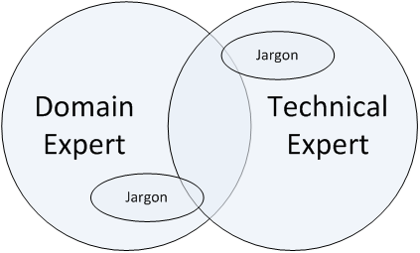
Ubiquitous language

Slide 20

Aha!
Notes:
You may or may not have already had that moment, but if you haven’t, don’t worry – at some point it all becomes clear.
You just have to keep at it a little bit more.
My colleague and the reason for the title of this session had the “aha!” moment after coming back from the Xmas break where he had left stating that over the holidays he would be “free from the shackles of TDD”.

Slide 21

It’s a long journey
Starting here
Want to get here
Notes:
Being open minded was important because it is a long journey and it takes time to embed the new ways of doing things.
During the adoption of the new processes it can often feel like you have a lot of hills to climb and chasms to cross but stick with it and you will get there.

Slide 22

The Curse of Knowledge
Design Patterns
Html
Selenium
CSS
Moq
Xpath
C#
SpecFlow
NUnit
SOLID Principles
Generics
Dependency Injection
BDD
Should

Slide 23

Learning can be hard!
STRETCH
COMFORT
PANIC
Notes:
It is important to note that whenever we try to learn new things it can be quite a hard process.
I just wanted to introduce the term COMFORT, STRETCH, PANIC – has anyone heard of this before?
The basic idea is that we do our best learning when we are being stretched instead of working within our comfort zone, but it is important not to stretch ourselves too far as this can push us into panic which then results in poor learning.

Slide 24
The goal: Feature development
Regression Test
Regression Test
Regression Test
Regression Test
Regression Test
Automation
Pre-Plan
Develop
Verification
Pre-Plan
Developers
Move to next feature
Pre-Plan
Test Automation
Verification
Pre-Plan
Testers

Slide 25
Automation Triangle
Manual Tests
UI Tests
Integration Tests
Unit Tests
Notes:
In an ideal world your automation should be more like this

Slide 26
Ice Cream Cone Anti-Pattern
Manual Tests
UI Tests
Integration Tests
Unit
Tests
Notes:
More testers means Dev’s think they don’t have to test

Slide 27
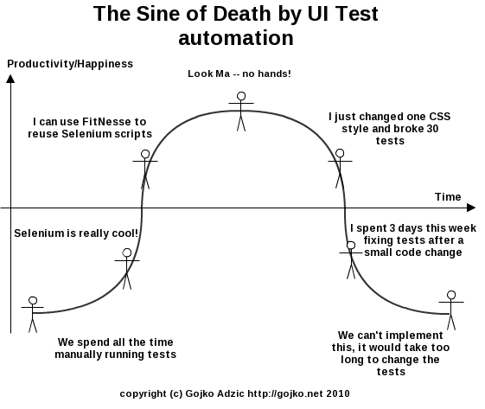
Death by UI Tests
Notes:
When people first start getting into UI testing this is typically what happens

Slide 28
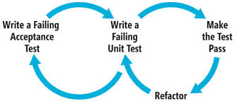
The BDD Cycle
Pre-Feature Image
Notes:
BDD is complementary to TDD

Slide 29

Pick the right level for you

Slide 30
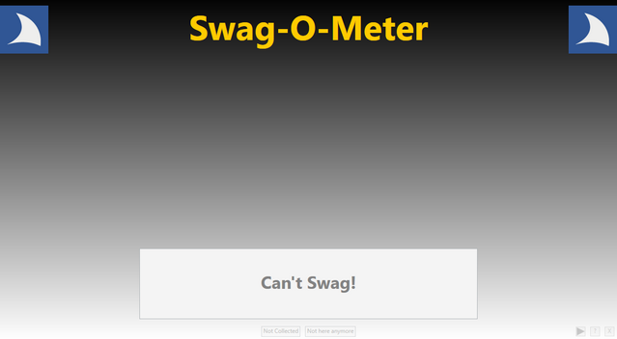
A new Swag-O-Meter

Slide 31
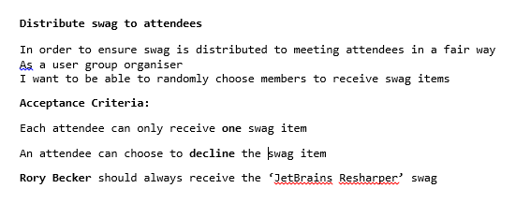
Early Requirement
Notes:
A typical requirement might come in like this

Slide 32
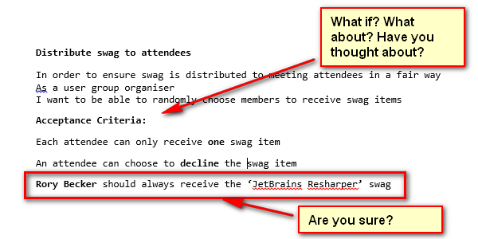
Pre-planning
Notes:
Sit down with BA, Testers, Developers, Product Owner – ask questions refine the acceptance criteria
Can I have an example ?

Slide 33
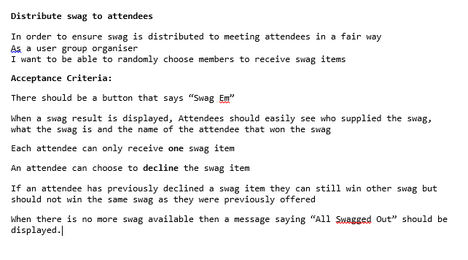
Planning/Pre-planning
Notes:
A firmer idea of what is required.

Slide 34
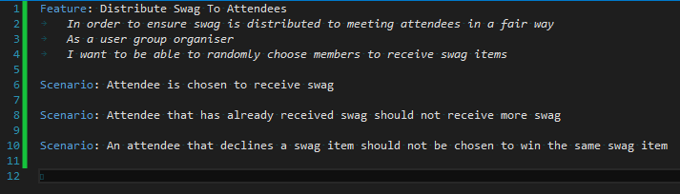
Define Scenarios
Notes:
From initial requirements outline scenarios are defined
This is typical performed by a developer and a tester as a pair
Double check those scenarios with BA/Product Owner

Slide 35
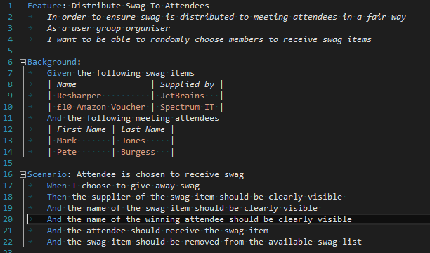
Expand Scenarios
Notes:
Further expansion performed by Developer and Tester, any questions about unclear scenarios raised with BA/PO.
No code written at this point.

Slide 36
Who writes/implements
Great at testing
Testers
Cross functional team
Developers
Great at developing
Notes:
How much you do all depends on where you and your team are?
Are you truly cross functional?
What can you do today that would make you more cross functional?

Slide 37
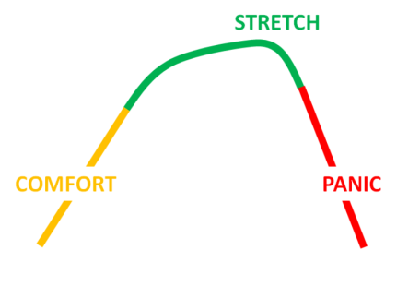
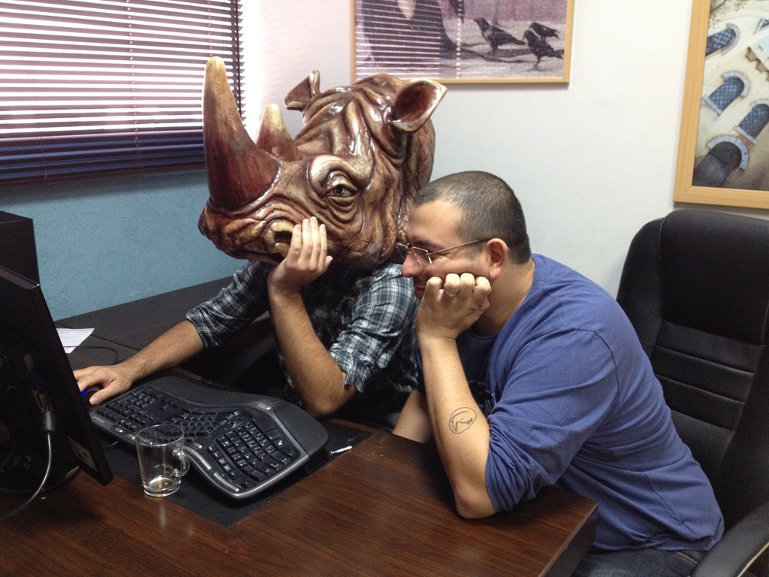
Pair programming

Slide 38

SpecFlow Demo
Notes:
Before we go into the demo it is worth exploring what our current understanding of a unit test is.

Slide 39
What is a unit test
External/3rd Party service
User Interface
A unit
Database
Unit Test Boundary
Notes:
There are lots of definitions of what a unit test is, a lot of people consider a unit test to be at class level.
My personal approach is to consider a unit test to be anything that can does not cross an interface boundary i.e. a user interface, a third party service or a database

Slide 40
Unit testing: Red
Tests
External/3rd Party service
User Interface
Nothing implemented yet
Database
Unit Test Boundary
Notes:
To achieve unit testing red which write the initial test and have not implementation

Slide 41
Unit testing: Green
External/3rd Party service
Tests
User Interface
Controller
Mock these
Database
Controller talks directly to the database – quick and dirty!
Unit Test Boundary
Notes:
Next we get the test green as quickly as possible by implementing a quick and dirty controller that interacts with mock versions of the external data stores

Slide 42
Unit testing: Refactor
External/3rd Party service
Test this
User Interface
Mock these
Controller
IService
IRepository
Database
Make the logic more maintainable
Unit Test Boundary
Notes:
Finally, we refactor the internals of our controller to ensure we follow the single responsibility principle and make or code more maintainable.
Once we have our tests to ensure that the behaviour of the system is correct, we can refactor the internal architecture as much as we like without impacting the tests.
This approach can help our tests to be less brittle and does not require as many code changes when we want to change how we implement the behaviour of the system.

Slide 43
What is a Black box test?
External/3rd Party service
Mock this
Tests
User Interface
Database
Browser/ Desktop App
Black Box
API
Automates
Black box test
Utilises
Black Box Test Boundary
Notes:
A black box test takes the boundary up a level and begins automating the UI and exercising the external facing API.
The key is to only interact with the external end points of the application, where possible this would be the User Interface and APIs.

Slide 44

Consistency
Notes:
By taking this approach to unit testing one key benefit that emerges from using BDD is the ability to keep consistency between your test approaches.
We can use the same language concepts to write tests at all levels of our application.

Slide 45
Project Structure
Black Box Solution
Application Solution
Black Box Tests
Application
Unit Tests
Features
Application host
Features
Models
Steps
Steps
Views
Pages
Test Data
Controllers
Test Data
Notes:
This diagram shows a typical visual project structure that I would use.
Notice that the Black Box Tests folder structure and the Unit Test folder structure, they are consistent.
This means that when testers/developers switch between the unit and black box tests they are already familiar with the layout and how things fit together.

Slide 46
Nuget Packages
BlackBox
Selenium Web Driver
Nunit
SpecFlow
Should
Unit Tests
Selenium Web Driver
Nunit
SpecFlow
Should
Moq
Implementation
ASP .NET MVC
Simple Injector
Web Api
Angular Js

Slide 47
Demo

Slide 48
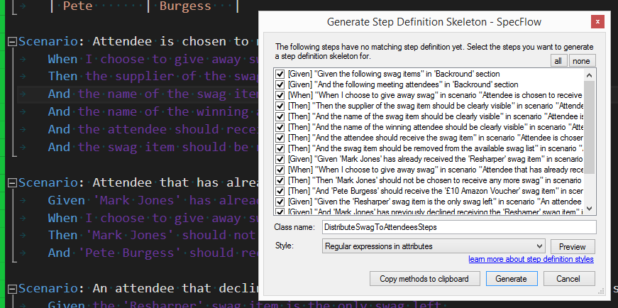
Generating step definitions
Notes:
Generates a

Slide 49
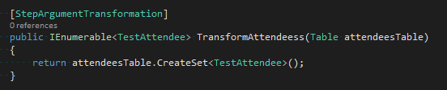
Step Argument Transforms

Slide 50
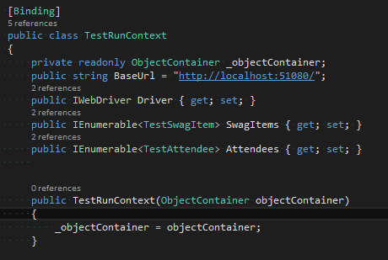
Dependency Injection

Slide 51
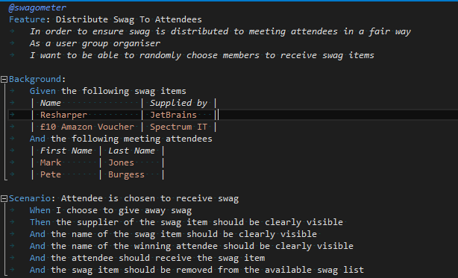
Tags

Slide 52
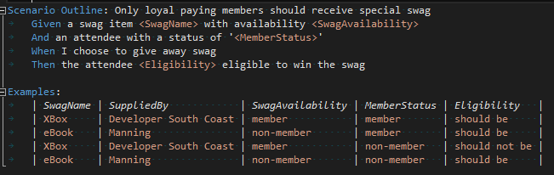
Scenario Outline

Slide 53
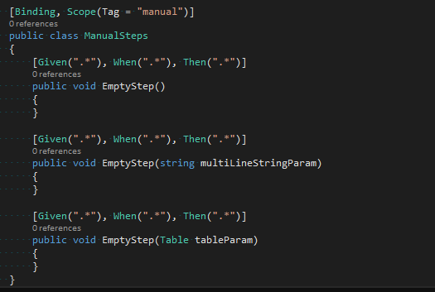
Scoping

Slide 54
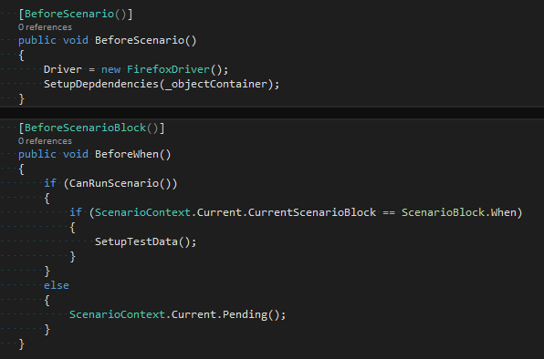
Hooks

Slide 55
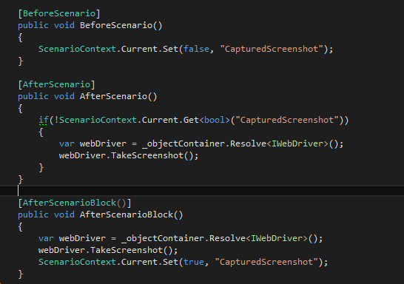
Capturing screenshots

Slide 56
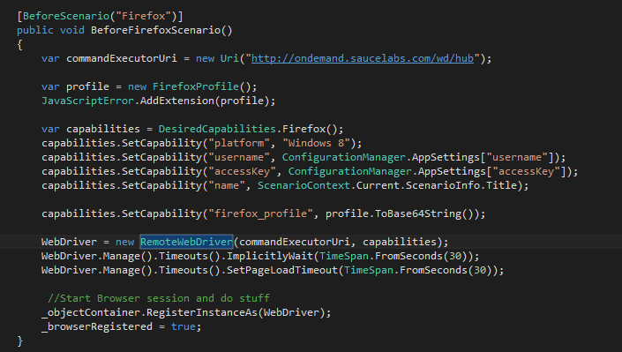
Sauce Labs
Cloud based testing

Slide 57
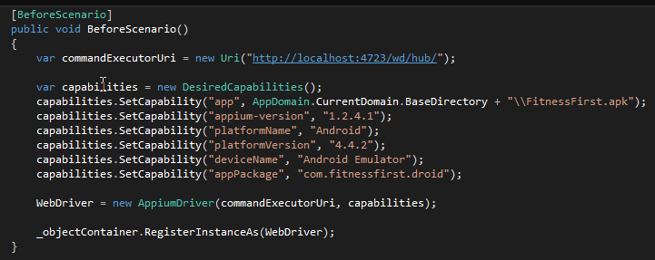
Appium
Mobile App Testing

Slide 58
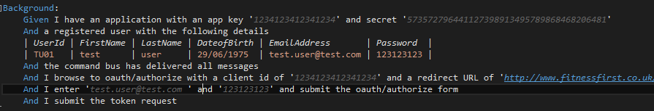
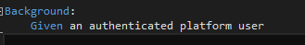
Background abuse

Slide 59
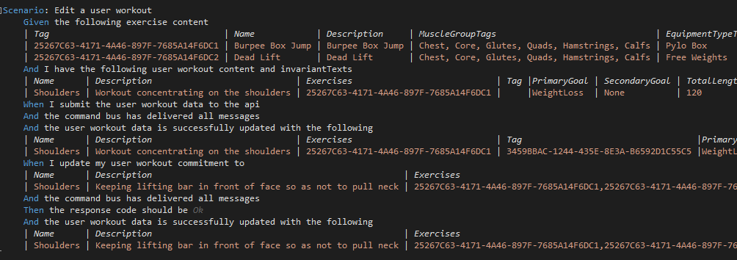
Table abuse

Slide 60
Summary
Communication over Automation
Take time to understand
Take part
Treat your tests like your code
Be thorough

Slide 61
Any Questions?

Slide 62
Resources
Books: Specification By Example
http://dannorth.net/
http://lizkeogh.com/
http://richallen.blogspot.com
Richard Allen
t: @rich_allen
e: rich@leavewizard.com

